Slide 1
Web Service

Slide 2
Web Services are….
A specific technology upon which SOA’s can be implemented.
(generic) a service offered by an electronic device to another electronic device, communicating with each other via the World Wide Web, or
(specific) a web service implemented in the particular technology or brand, e.g., SOAP in World Wide Web Consortium (W3C) Web Services.
In a web service, the Web technology such as HTTP—originally designed for human-to-machine communication—is utilized for machine-to-machine communication, more specifically for transferring machine-readable file formats.

Slide 3
Web Services Evolution
Notes:
They represent the convergence between a service-oriented architecture and the Web

Slide 4




Web Evolution
XML
HTTP / HTML
Technology
TCP/IP
Connectivity
Presentation
Programmability
FTP, E-mail, Gopher
Innovation
Web Pages
Browse the Web
Web Services
Program the Web

Slide 5
What are web services good for?
One of the more important innovations in Web Services is “machine-to-machine communications.”
This means that a Web Service can ask another Web Service to do something, and that Web Service can ask another Web Service to do something, and so on.
In the future, many Web Services will really just be aggregations of other Web Services.

Slide 6
Web Service Architectures
Two main approaches:
SOAP (Simple Object Access Protocol)
REST (Representational State Transfer)

Slide 7
XML Introduction

Slide 8
An example of XML
<?xml version="1.0" encoding="UTF-8"?>
<note>
<to>Bob</to>
<from>Alice</from>
<heading>Reminder</heading>
<body>The plan for this weekend.</body>
</note>

Slide 9
Difference between XML and HTML
XML was designed to carry data, not displaying data
XML is not a replacement for HTML.
Different goals:
XML was designed to describe data and to focus on what data is. HTML was designed to display data and to focus on how data looks.
HTML is about displaying information, and XML is about describing information.

Slide 10
Why Is XML Important?
Plain Text
Easy to edit
Useful for storing small amounts of data
Possible to efficiently store large amounts of XML data through an XML front end to a database
Data Identification
Tell you what kind of data you have
Can be used in different ways by different applications

Slide 11
Why is XML important?
Hierarchical
Faster to access
Easier to rearrange
Easily Processed
Regular and consistent notation
Vendor-neutral standard

Slide 12
XML Building blocks
Element
Delimited by angle brackets
Identify the nature of the content they surround
General format: <element> … </element>
Empty element: <empty-Element/>
Attribute
Name-value pairs that occur inside start-tags after element name, like: <element attribute=“value”>

Slide 13
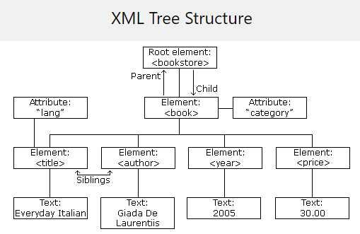
XML Structure
<?xml version="1.0" encoding="UTF-8"?> <bookstore> <book category="cooking"> <title lang="en">Everyday Italian</title> <author>Giada De Laurentiis</author> <year>2005</year> <price>30.00</price> </book> </bookstore>

Slide 14
XML Application 1—Separate data
XML can Separate Data from HTML
Store data in separate XML files
Using HTML for layout and display
Benefits:
Changes in the underlying data will not require any changes to your HTML

Slide 15
XML Application 2—Exchange data
XML is used to Exchange Data (web services)
Text format
Software-independent, hardware-independent
Exchange data between incompatible systems, given that they agree on the same tag definition.
Can be read by many different types of applications
Benefits:
Reduce the complexity of interpreting data
Easier to expand and upgrade a system

Slide 16
XML Application3—Store Data
XML can be used to Store Data
Plain text file
Store data in files or databases
Application can be written to store and retrieve information from the store
Other clients and applications can access your XML files as data sources
Benefits:
Accessible to more applications

Slide 17
HTTP

Slide 18
An HTTP conversation
Client
Server
OK
Send page or error message
OK
I would like to open a connection
GET <file location>
Display response
Close connection
HTTP is the set of rules governing the format and content of the conversation between a Web client and server

Slide 19
An HTTP example
The message requesting a Web page must begin with the work “GET” and be followed by a space and the location of a file on the server, like this:
GET /fac/lpress/shortbio.htm
The protocol spells out the exact message format, so any Web client can retrieve pages from any Web server.

Slide 20
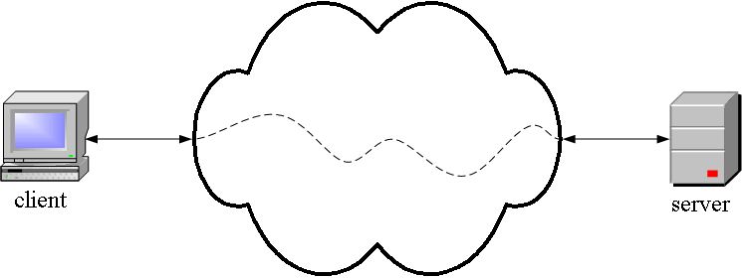
HTTP is an application layer protocol
The Web client and the Web server are application programs
Application layer programs do useful work like retrieving Web pages, sending and receiving email or transferring files
Lower layers take care of the communication details
The client and server send messages and data without knowing anything about the communication network

Slide 21
The application layer is boss – the top layer
Layer | Function
Application | Do useful work like Web browsing, email, and file transfer
Lower layers | Handle communication between the client and server
The application program says: Send this request to the server -- I don't care how you do it or whether it goes over phone lines, radio, or anything else about the details. Just send the message, and let me know when it arrives or if it cannot be delivered for some reason.
There are five layers, the application layer and four lower layers.
Similar example:
Your boss says: Send this package to Miami -- I don't care if you use Federal Express, UPS, or any other means. Also, let me know when it arrives or if it cannot be delivered for some reason.

Slide 22
HTTP 1.0
Request-Line
HTTP request line
Method
URI
Protocol version
Method [Request URI] HTTP/1.0
GET /hello.html HTTP/1.0
Test: in terminal
telnet www.httpforever.com 80
GET / HTTP/1.0
Headers
.
.
.
blank line
Content...

Slide 23
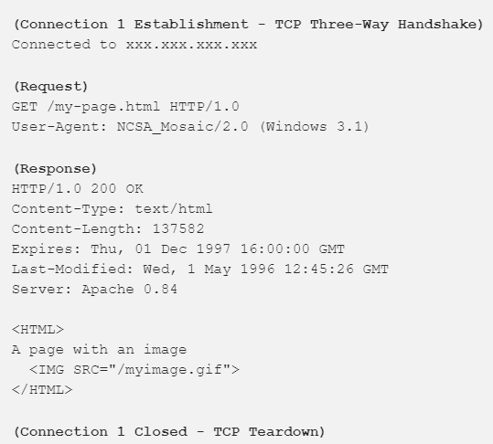
HTTP 1.0
Method
Get
Retrieve information identified by the URL.
Head
Only returns information about data (metadata)
Post
Sends/creates something to server, and retrieve result
Connection nature: terminated immediately after the response

Slide 24
HTTP 1.1 – improvement from HTTP 1.0
This is the HTTP version currently in common use.
Additional Methods
Put
Store/update information in location named by URL
Delete
Remove entity identified by URL
Connection nature: long-lived

Slide 25
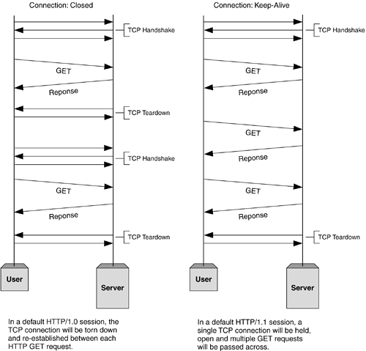
HTTP 1.0 vs. HTTP 1.1
Before establishing any connection, a TCP three-way handshake happens.
At the end, after sending all data to Client, Server sends a message saying there’s no more data to send. Then the client closes the connection (TCP teardown).
The problem in HTTP/1.0 is, for each request-response cycle, a connection needs to be opened and closed.
And the advantage of using HTTP/1.1 is, we can reuse the same open connection for multiple request-response cycles.

Slide 26
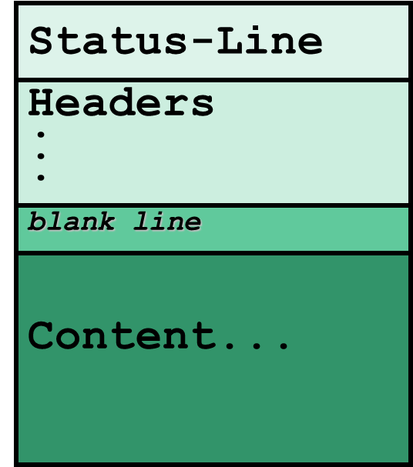
HTTP response
Status line
HTTP-version Status-code Reason
Status-codes 1xx - Informational
Reserved for future use
Status-codes 2xx - Success
The action was successfully received, understood, and accepted
200 OK
201 POST command successful
202 Request accepted
203 GET or HEAD request fulfilled
204 No content

Slide 27
HTTP response
Status line
Status-codes 3xx - Redirection
Further action must be taken in order to complete request
300 Resource found at multiple locations
301 Resource moved permanently
302 Resource moved temporarily
304 Resource has not modified (since date)
Status-codes 4xx - Client error
The request contains bad syntax or cannot be fulfilled
400 Bad request from client
401 Unauthorized request
402 Payment required for request
403 Resource access forbidden
404 Resource not found
405 Method not allowed for resource
406 Resource type not acceptable

Slide 28
HTTP response
Status line
Status-codes 5xx - Server error
The server failed to fulfill an apparently valid request
500 Internal server error
501 Method not implemented
502 Bad gateway or server overload
503 Service unavailable / gateway timeout
504 Secondary gateway / server timeout

Slide 29
Stateless
HTTP is stateless
Each request requires separate TCP connection
Server doesn’t remember previous requests
From one web page to the next there is nothing in the protocol that allows a web program to maintain program “state” (like a desktop program).
To maintain state:
Session: on server’s side
Cookie: in client’s browser

Slide 30
SOAP

Slide 31
SOAP Web Services
SOAP (simple object access protocol) is a protocol for exchanging XML-based messages over networks, generally via HTTP and HTTPS.
Successor to XML-RPC, CORBA, DCOM. Huge improvement over CORBA.
XML-RPC is a remote procedure call (RPC) protocol which uses XML to encode its calls and HTTP as a transport mechanism.
Unlike CORBA and DCOM messaging, layering SOAP on HTTP makes it play well with proxies and firewalls. XML messages are another big win.
Created by Microsoft and DevelopMentor in 1999, given to the W3C for standardization. SOAP is now the core component of the W3C’s “WS-*” web services standards.
Allied WS-* standards include UDDI for discovering web services and WSDL for describing web service APIs.
SOAP supports various messaging patterns, but the remote procedure call (RPC) pattern is very predominantly used.

Slide 32
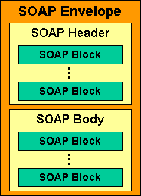
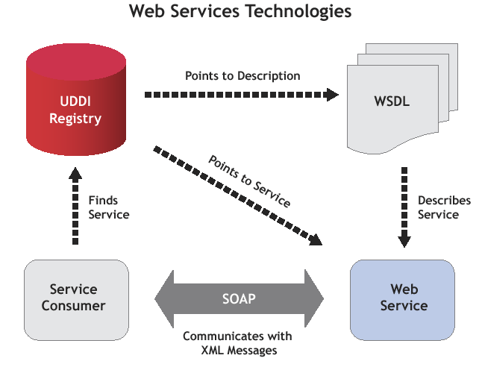
Overview

Slide 33
SOAP
Server A
Client
(1) UDDI request: Where can I find a “weather service”?
Discovery Service (UDDI)
(2) UDDI response: There is a “weather service” on Server B
Server B
(3) How exactly do I invoke you?
Web Service
(4) Take a look at this: WSDL
(5) SOAP request: Invoke getWeatherInfo() with parameter ‘60196’
(6) SOAP response: Severe thunderstorms with flooding

Slide 34
XML-RPC: Example
An example of a typical XML-RPC request would be:
<?xml version="1.0"?>
<methodCall>
<methodName>examples.getStateName</methodName>
<params>
<param>
<value><i4>40</i4></value>
</param>
</params>
</methodCall>

Slide 35
XML-RPC: Example
An example of a typical XML-RPC response would be:
<?xml version="1.0"?>
<methodResponse>
<params>
<param>
<value><string>South Dakota</string></value>
</param>
</params>
</methodResponse>

Slide 36
REST

Slide 37
Web Design, Axiom 0 (Tim Berners-Lee, director of W3C)
Axiom 0: all resources on the Web must be uniquely identified with a URI.
URL1
resource1
URL2
resource2
URL3
resource3

Slide 38
Fundamental Aspects of the REST Design Pattern
Resources Every distinguishable entity is a resource. A resource may be a Web site, an HTML page, an XML document, a Web service, a physical device, etc.
URLs Identify Resources Every resource is uniquely identified by a URL. This is Tim Berners-Lee Web Design, Axiom 0.

Slide 39
Representational State Transfer (REST)
A style of software architecture for distributed hypermedia systems such as the World Wide Web.
Introduced in the doctoral dissertation of Roy Fielding
One of the principal authors of the HTTP specification.
A collection of network architecture principles which outline how resources are defined and addressed

Slide 40
Main Concepts
Nouns (Resources) e.g., http://example.com/employees/12345
REST
Verbs e.g., GET
Representations e.g., XML

Slide 41
Resources
The key abstraction of information in REST is a resource.
A resource is a conceptual mapping to a set of entities
Any information that can be named can be a resource: a document or image, a temporal service (e.g. "today's weather in Los Angeles"), a collection of other resources, a non-virtual object (e.g. a person), and so on
Represented with a global identifier (URL in HTTP)
Each resource is linked to other resources.
http://www.boeing.com/aircraft/747

Slide 42
Naming Resources
REST uses URL to identify resources
http://localhost/books/
http://localhost/books/ISBN-0011
http://localhost/books/ISBN-0011/authors
http://localhost/classes
http://localhost/classes/cs2650
http://localhost/classes/cs2650/students
As you traverse the path from more generic to more specific, you are navigating the data

Slide 43
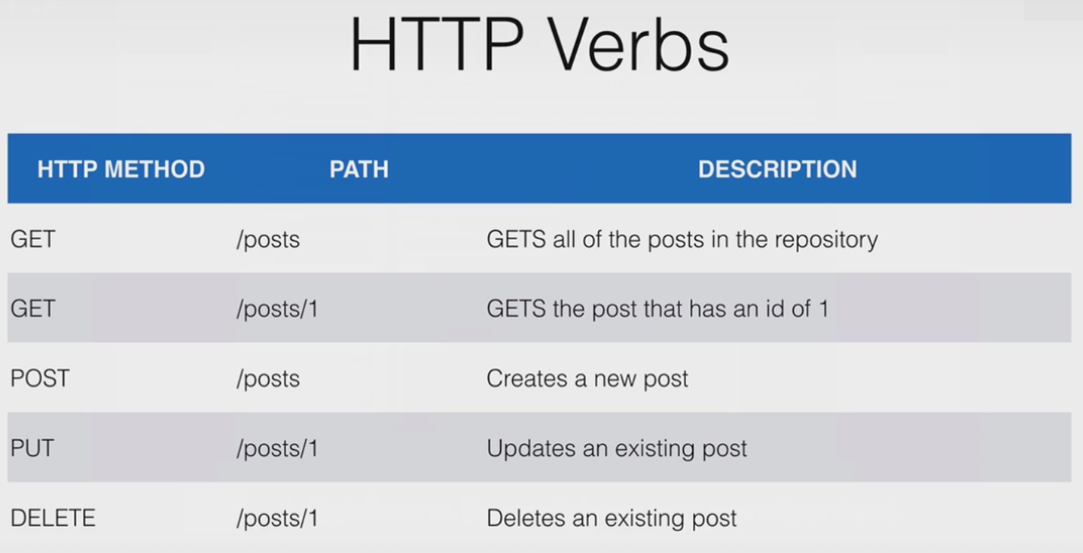
Verbs
Represent the actions to be performed on resources
HTTP GET, HTTP POST, HTTP PUT, HTTP DELETE

Slide 44
HTTP GET
How clients ask for the information they seek.
Issuing a GET request transfers the data from the server to the client in some representation
GET http://localhost/books
Retrieve all books
GET http://localhost/books/ISBN-0011021
Retrieve book identified with ISBN-0011021
GET http://localhost/books/ISBN-0011021/authors
Retrieve authors for book identified with ISBN-0011021

Slide 45
HTTP PUT, HTTP POST
HTTP POST creates a resource
HTTP PUT updates a resource
POST http://localhost/books/
Content: {title, authors[], …}
Creates a new book with given properties
PUT http://localhost/books/isbn-111
Content: {isbn, title, authors[], …}
Updates book identified by isbn-111 with submitted properties

Slide 46
HTTP DELETE
Removes the resource identified by the URI
DELETE http://localhost/books/ISBN-0011
Delete book identified by ISBN-0011

Slide 47
Representations
How data is represented or returned to the client for presentation.
Two main formats:
JavaScript Object Notation (JSON)
XML
It is common to have multiple representations of the same data

Slide 48
Representations
XML
<COURSE>
<ID>CS2650</ID>
<NAME>Distributed Multimedia Software</NAME>
</COURSE>
JSON
{course
{id: CS2650}
{name: Distributed Multimedia Sofware}
}

Slide 49
Why is it called "Representational State Transfer"?
Resource
Client
http://www.boeing.com/aircraft/747
Fuel requirements
Maintenance schedule
...
Boeing747.html
The Client references a Web resource using a URL. A representation of the resource is returned (in this case as an HTML document).
The representation (e.g., Boeing747.html) places the client application in a state. The result of the client traversing a hyperlink in Boeing747.html is another resource accessed. The new representation places the client application into yet another state. Thus, the client application changes (transfers) state with each resource representation --> Representational State Transfer!

Slide 50
"Representational State Transfer is intended to evoke an image of how a well-designed Web application behaves: a network of web pages (a virtual state-machine), where the user progresses through an application by selecting links (state transitions), resulting in the next page (representing the next state of the application) being transferred to the user and rendered for their use."
Roy Fielding.

Slide 51
REST Properties (Connectedness)
a
b
c
Three services (a-c) expose identical functionality with increasing usability.
A pure RPC web service with just a single URI. The service is neither addressable nor connected. SOAP services generally are pure RPC.
A web service where resources are addressable, but not connected (for instance, some REST/RPC hybrid web services).
A fully RESTful web service: resources are addressable and connected.
Source: RESTful Web Services, Leonard Richardson and Sam Ruby
Notes:
Start here Monday 3/26

Slide 52
Architecture Style
Request
(XML doc)
HTTP GET
URL 1
doGet()
Response
(XML doc)
HTTP Response
doPost(id)
Request
(XML doc)
HTTP POST
URL 1
REST Engine
(locate resource and generate response)
Web/Proxy Server
Response
(JSON doc)
HTTP Response
doDelete()
PO
(XML doc)
HTTP DELETE
URL 1
Response
(TEXT doc)
HTTP Response

Slide 53
From Non-REST to REST
Many abstract concepts in a procedural API get mapped into “concrete” resources in REST:
setUserLastName() becomes
PUT www.example.com/user/{userid}
findUsersFromOrganization() becomes
GET www.example.com/users-in-org/{org}

Slide 54
SOAP vs. REST

Slide 55
SOAP
SOAP is a full set of standards, based on the RPC paradigm.
Every object has its own unique methods
Methods can be remotely invoked over the Internet
A single URL represents the end-point, and that's the only contact with the Web
Data hidden behind method calls and parameters
Data is unavailable to Web applications

Slide 56
REST
REST approaches are much simpler than SOAP.
Every useful data object has an address.
Resources themselves are the targets for method calls.
The list of methods is fixed for all resources.
Crucial for efficiency, scalability, fault tolerance:
Load balancers can route requests to any web server.
Web server going down has only minor impact.
Just add more web servers for horizontal scaling.

Slide 57
SOAP vs. REST
A SOAP service has a single endpoint that handles all the operations – therefore it has to have an application-specific interface.
A RESTful service has a number of resources (the collection, each entry), so the operations can be distributed onto the resources and mapped to a small uniform set of operations.

Slide 58
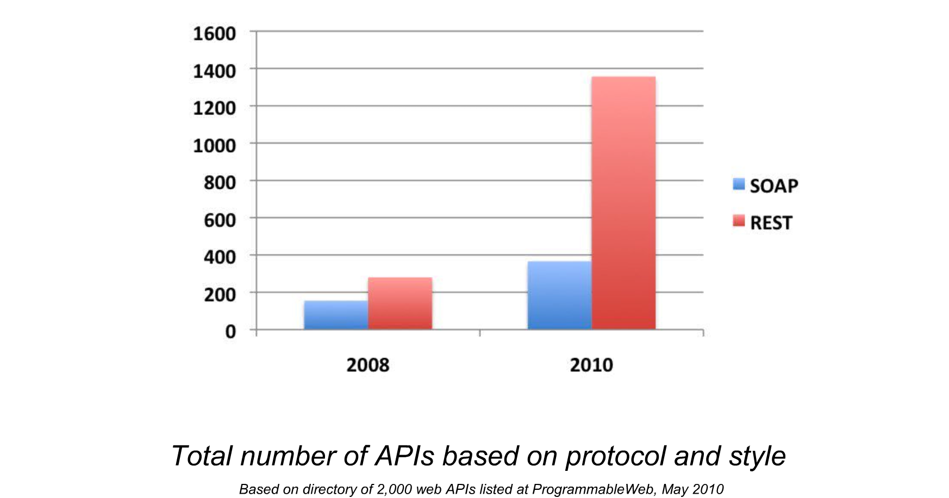
REST vs. SOAP: # of APIs
Credits: http://www.slideshare.net/jmusser/pw-glue-conmay2010

Slide 59
Conclusion
REST and SOAP are both good techniques to know.
Use SOAP for tasks that are naturally RPC.
Use REST for web services that are naturally about managing content.
Use REST when scalability is a concern.

